Slide 1
Welcome Members and Guests to The European Union General Data Protection Regulation Program

Slide 2
Special Thanks to Our Host!

Slide 3
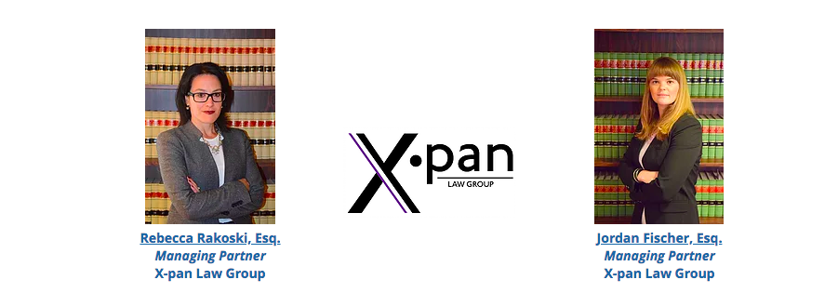
Meet our Speakers!

Slide 4
Merci Beaucoup for Your Participation!

